Slide 1






Hypnos
To dream once again!
Sleep monitoring application
to treat insomnia
Medical Informatics Project - Group 21 A.Y. 24-25
Bianca Agostinis, Samuel Astuni, Edoardo Brunello, Sabrina de Felice, Paolo Di Ciano, Leonardo Pellecchia

Slide 2





Insomnia
Low productivity
Cognitive issues
Health risks
SHORT TERM
TIME
LONG TERM

Slide 3

Statistics
65%
Women
1/3
60+ years old
10mln+
in Italy
Prevalence (%)

Slide 4



IMPACT OF TELEMONITORING
Location-based
participation barrier
Online access facilitation
Artificiality of clinical sleep setting
Genuine sleep patterns in natural setting
Excessive time spent on administrative interactions
Optimized virtual patient interactions
LIMITATION
SOLUTION

Slide 5



OUR SOLUTION: HYPNOS
PATIENT-DOCTOR COMMUNICATION
Patients and physicians can exchange therapy updates remotely, eliminating the need for in-clinic visits
SCHEDULING AND PRESCRIBING
The app facilitates calendar-based scheduling and streamlined prescription of therapies or medications
HOME MONITORING
Patients can independently monitor sleep through the device and provide follow-up insights via questionnaires for medical evaluation

Slide 6






ACTORS & ACTIVITIES
Patient
Diagnosed with insomnia, monitored at home via wearable and app
Sleep Specialist
Diagnoses, monitors remotely and adjusts therapy
Device
Ring that tracks sleep metrics and
sends data
App
Connects all actors, collects data, generates reports, and manages care
Database
Securely stores all sleep data, reports, and clinical records for real-time access

Slide 7






ASSUMPTIONS
for our case
Patient already diagnosed with insomnia
Patient owns a smartphone
Device provided by the clinic
All doctors within the same clinic

Slide 8

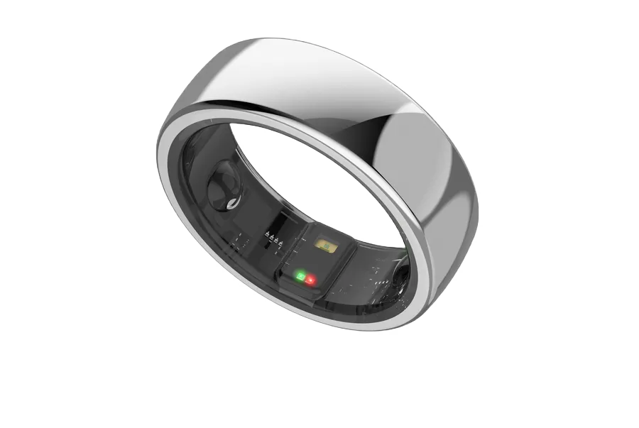

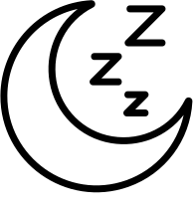

OUR DEVICE
COMFORT
Our ring device is lightweight and ergonomically designed to ensure all-day comfort without interfering with daily activities or sleep
BLUETOOTH CONNECTION
Our ring device features a stable and energy-efficient Bluetooth connection for seamless data transfer to smartphone or tablet
SLEEP MEASUREMENTS
Our ring device continuously monitors heart rate, blood oxygen saturation (SpO₂), movement index, sleep cycles, and sleep phase durations

Slide 9
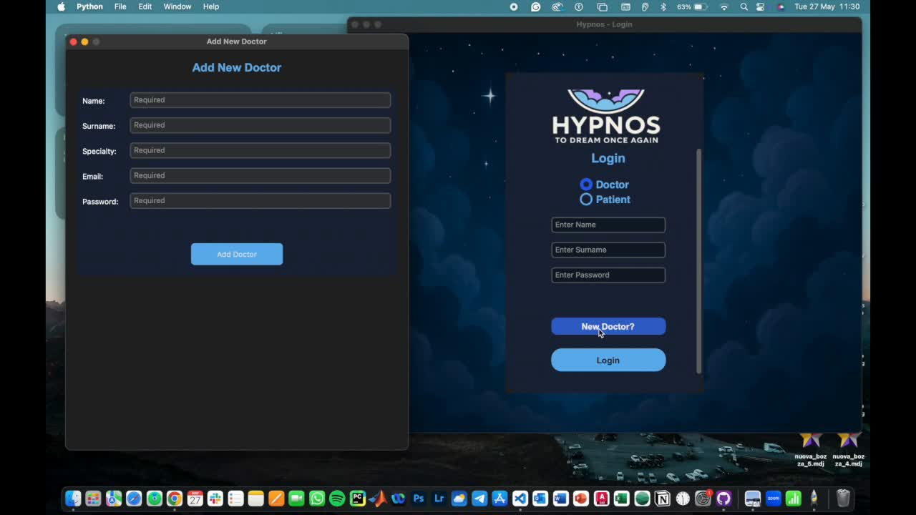
D
O
C
T
O
R
I
N
T
E
R
F
A
C
E

Slide 10
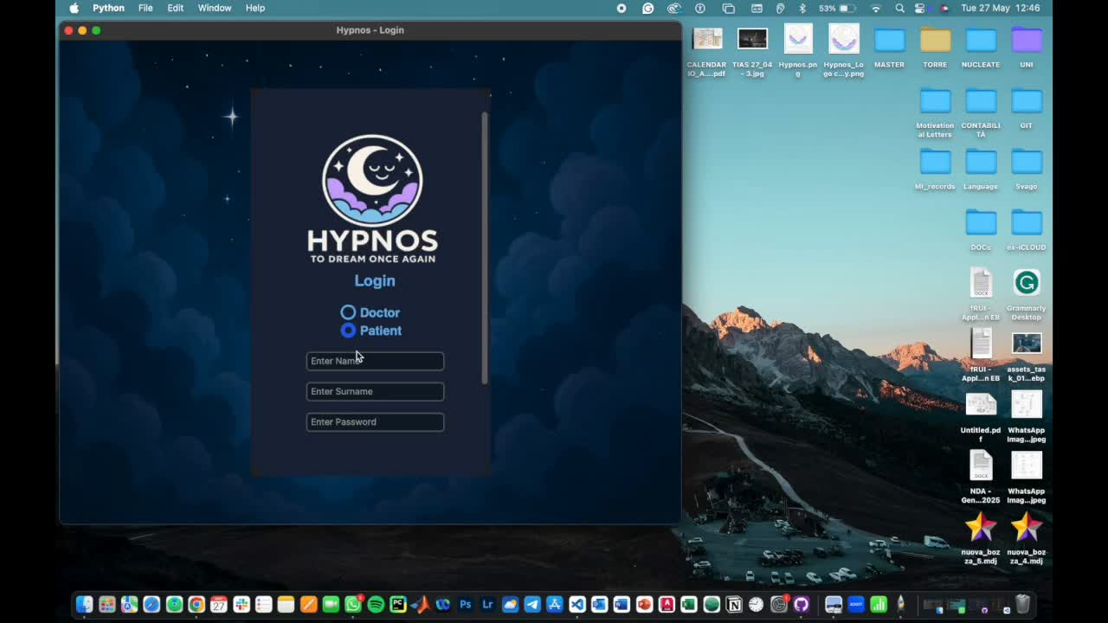
P
A
T
I
E
N
T
I
N
T
E
R
F
A
C
E

Slide 11

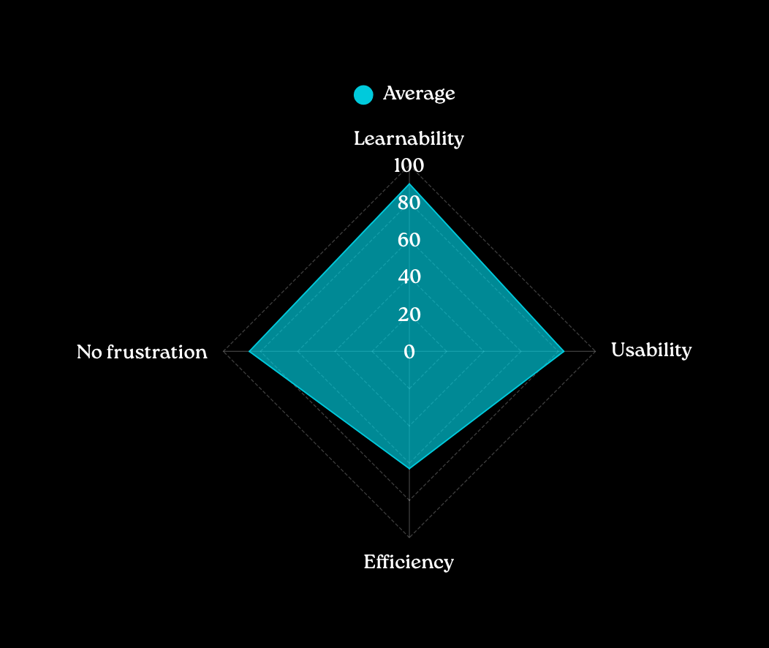
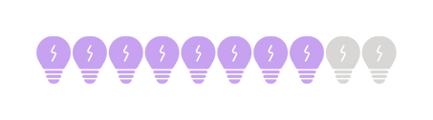
USABILITY TESTING
10 test-users were enrolled to test our app Hypnos. They were then given the System Usability Scale (SUS) survey to fill
84%
±10%

Slide 12




Hypnos and ISO Standards on Usability
Specific User
Specific Goal
Insomnia patients using a wearable ring at home
Monitor sleep patterns long-term to guide treatment
Effectiveness
Efficiency
Continuous, objective data more accurate than self-reports
Limited lab visits, low effort for patients

Slide 13
Rethinking Sleep Assessment:
advantages of Hypnos
 | TRADITIONAL METHODS | HYPNOS
SETTING | Lab/Clinic | At home
DURATION | Short-term | Long-term
DATA TYPE | Subjective | Objective
ACCURACY | Self-report bias | Real-world data
USER EXPERIENCE (UX) | Disruptive and artificial | Familiar setting

Slide 14
LIMITATIONS
Device-dependent data reliability
High price
Notification system not integrated
Lack of a live chat feature for IT support
Small community:
system designed for use within a specific clinic

Slide 15






Future Developments and Applications
MARKET POTENTIAL
Path to commercialization
AI INTEGRATION
AI-based analytics and predictive models
EXTENSION TO OTHER SLEEP DISORDERS
e.g. sleep apnea, narcolepsy, ...
INTEGRATION WITH TELEMEDICINE PLATFORMS
Automatic transfer of monitoring data to patient’s Electronic Health Record
ACCESS TO OTHER SPECIALISTS
Expand the availablility to other healthcare professionals
DATA PRIVACY
Compliance with standards and GDPR legislation

Slide 16

Thanks
for your
attention!
Group 21

Slide 17
Bibliography
[1] C. et Fernandez-Mendoza J. Insomnia nosology: a systematic review and critical appraisal of historical diagnostic categories and current phenotypes, 2023​
​
[2] Polysomnography, Jessica Vensel Rundo and Ralph Downey, 2019​
​
[3] Clinical Applications of Mobile Health Wearable–Based Sleep Monitoring: Systematic Review, 2019 ​
​
[4] Milena K. Pavlova, MD, Veronique Latreille, “Sleep Disorders”, 2019​
​
[5] Sujay Kansagra, MD, "Sleep Disorders in Adolescents", 2020 ​
​
[6] National Sleep Foundation, “Consensus Statement on Sleep”, 2015 ​
[7] Klimnt et al, Insomnia symptoms in adulthood. Prevalence and incidence over 25 years
[8] Bastien et al. Validation of the Insomnia Severity Index as an outcome measure for insomnia research. (2001)
[9] Lewis, J. R., & Sauro, J. (2009). The Factor Structure of the System Usability Scale. In Human Centered Design, HCII 2009, LNCS 5619.

